Slide 1
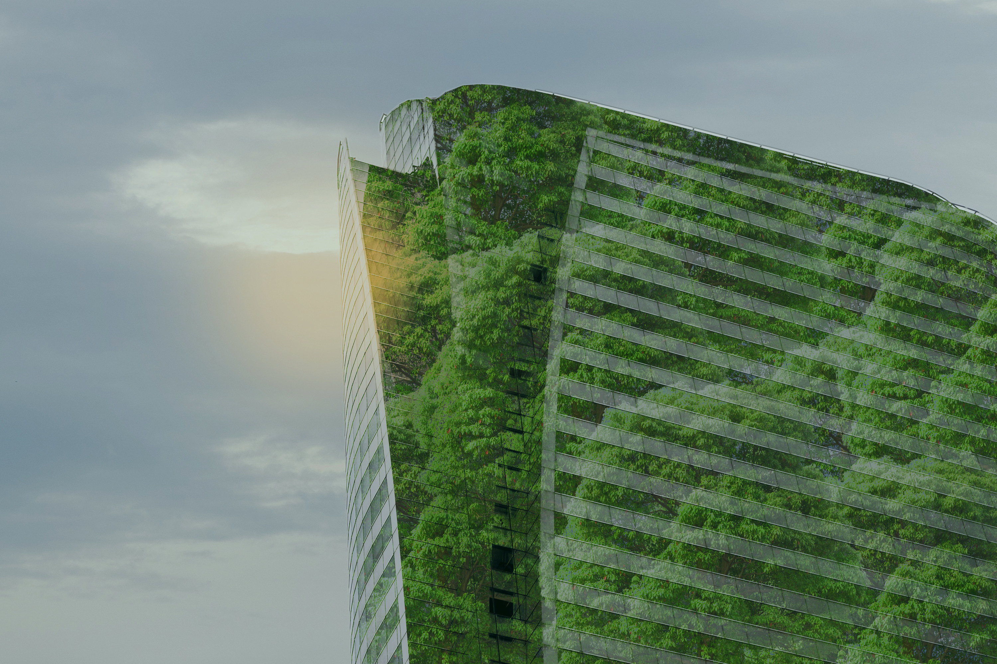


Ecoplate Co.
Sustainable Startup
Business Pitch Deck

Slide 2

01
Introduction
"Nourish, sustain, leave no trace."
We offer eco-friendly tableware, offering a stylish and guilt-free dining experience. We offer stylish solution to sustainable dining.

Slide 3


03
Problem
Most of the disposable tableware are ugly, expensive, or both.
The problem that Ecoplate Company addresses is the difficulty of finding products that are also stylish and affordable. Too often, sustainable products are either ugly or expensive (or both).
This makes it hard for people who care about the environment to find products that they actually want to use.
Paper/ foam
THE
PRODUCT
Expensive

Slide 4

04
Solution
We offer a solution to this problem with their line of sustainable products
Stylish and customizable eco-friendly tableware
Focus on aesthetics, enhance dining presentation
A superior alternative to paper-based tableware
Sturdy nature ensures that our products hold up well
Customization options to meet the unique needs

Slide 5
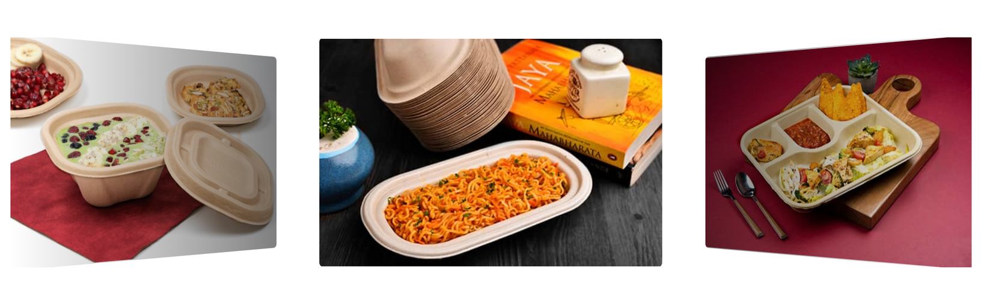
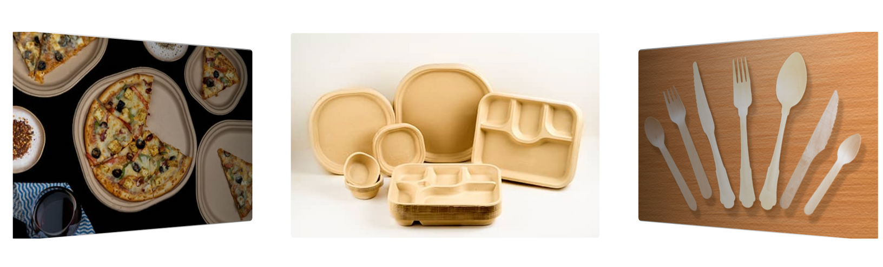
Example Product

Slide 6

02
The Market
The disposable tableware market is growing rapidly
There is an increase in the demand for paper cups and paper plates due to the rising awareness among the masses about the harmful impact of plastic and foam-based disposable utensils around the world.
Outbreak of the COVID-19 pandemic has led to an increasing utilization of disposable paper cups and paper plates
VMI Group expects the market to reach US$ 6.8 Billion by 2028

Slide 7

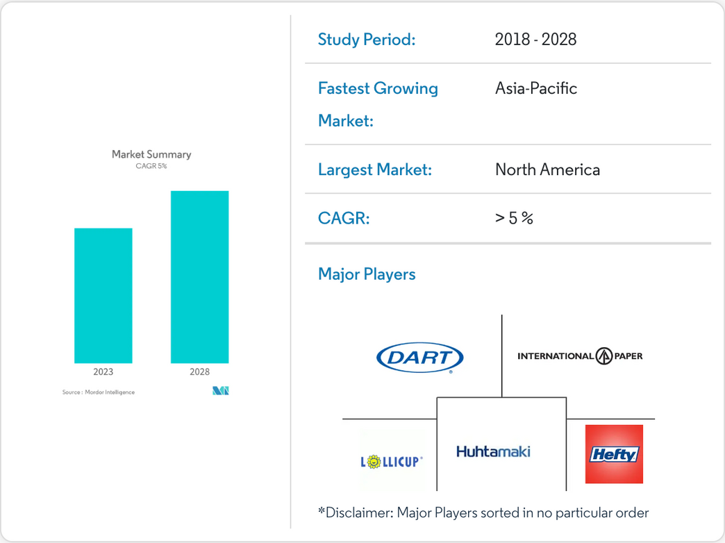
Disposable Tableware Market Growth and players
The rising demand for plastic-free products among consumers is driving the global Disposable Plates Market.
The rising use of disposable tableware worldwide is driving the global market for disposable paper plates.
Governments of countries across the world are imposing a ban on the usage of plastic products.

Slide 8




05
The Competition
There are a number of companies that offer products on similar line
Material Innovation
Design and Functionality
Customer Service
Customization
Durability
Sustainability

Slide 9
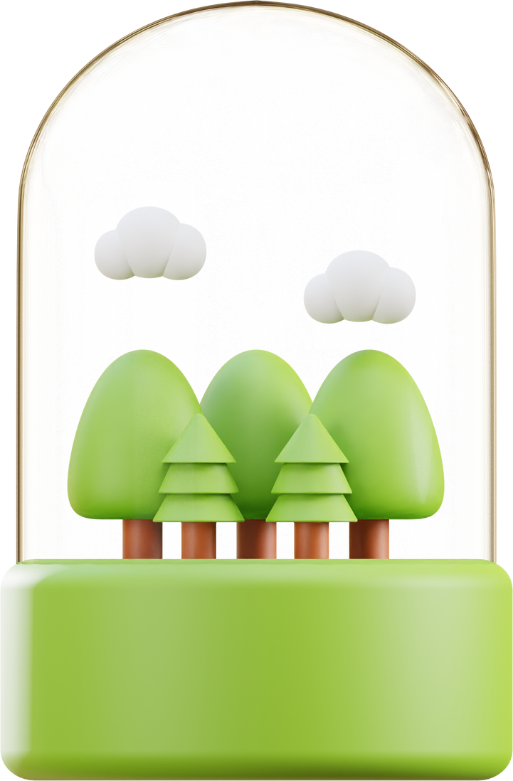
06
The Opportunity
Chance to support a company trying to do good to the planet
Research and Development
Marketing and Branding
Infrastructure and Equipment
Training and Staffing

Slide 10
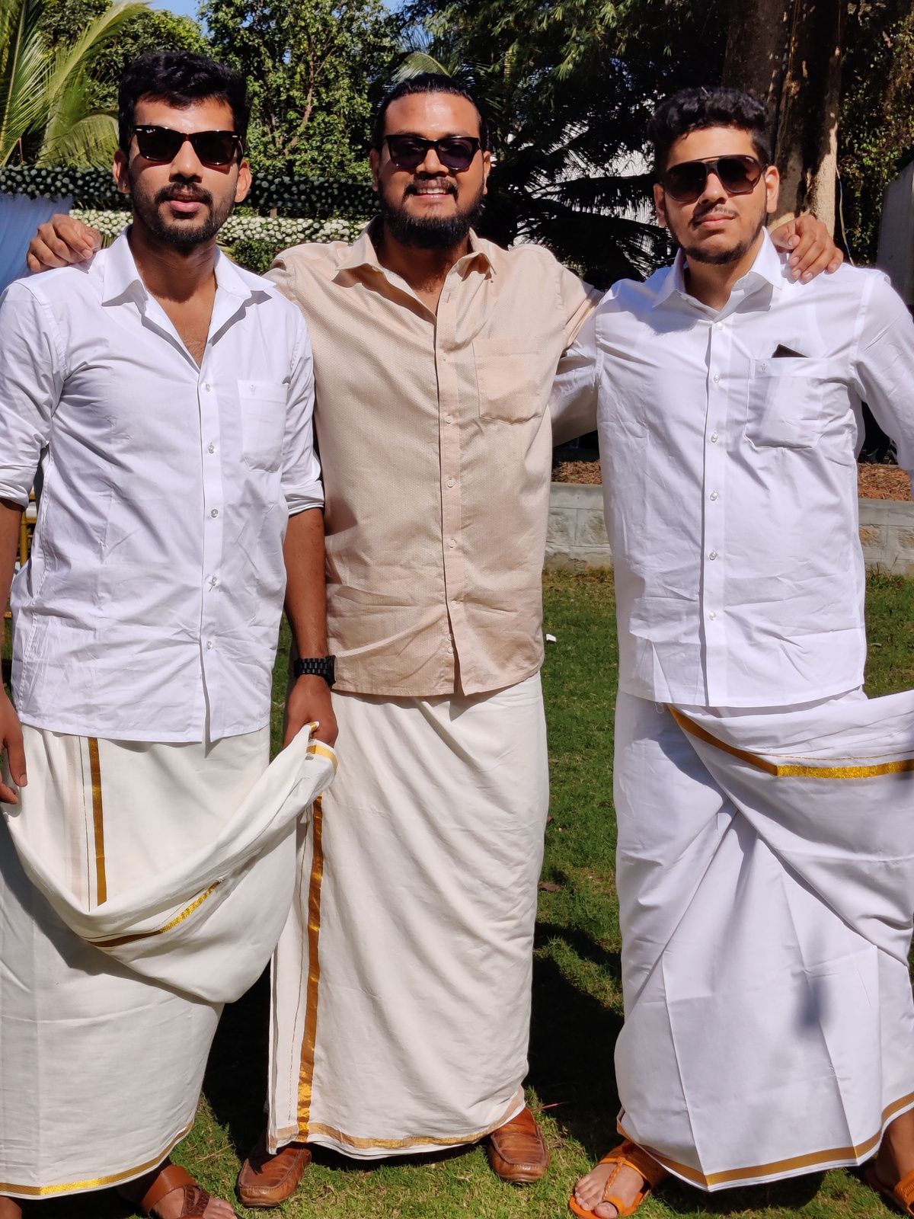
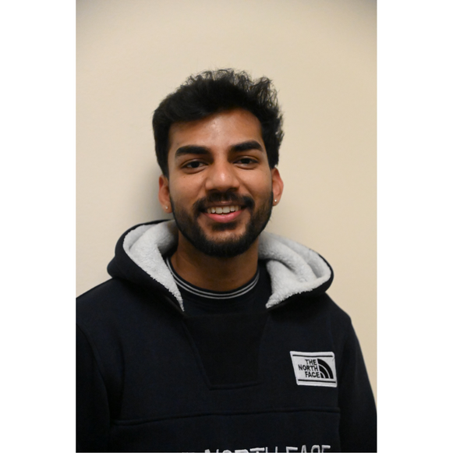
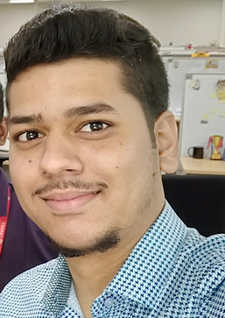
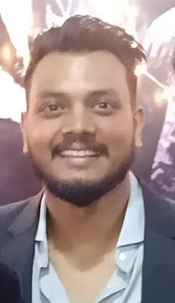
Our Team
Nourish, Sustain, Leave No Trace
Sudharshan Vyas
Design Manager
The designer manager role is similar to that of an art director, but with more emphasis on management and strategic planning
Sharath Kalappa
Ecoplater
Anish Nair
Work with the production team and engineers and designers to develop products that are sustainable and meet the needs of the customer.
Production Lead
Someone who evaluates different materials and production processes to find the most efficient and sustainable way to create a product.

Slide 11

07
The Future
The future looks bright for Ecoplate
Ecoplate is poised for success in the coming years. We have a strong product offering, strong product knowledge, and a mission that resonates with consumers. We believe that they will continue to grow in the sustainable product market and become a leading provider of eco-friendly products.
EcoPlate's innovative use of sugarcane bagasse, coupled with customizable designs and stylish aesthetics, positions us as a leader in the market, poised for rapid growth.

Slide 12

08
Conclusion
Ecoplate is a sustainable startup that is making a difference
By investing in EcoPlate, you have the opportunity to be part of a forward-thinking company that not only addresses a pressing environmental issue but also meets the rising demand for sustainable tableware. Join us in revolutionizing the industry, making a positive impact on the planet, and reaping the rewards of a growing market opportunity.

Slide 13



Ecoplate
Thank You
Any Questions?
312-532-6679
skalappa@depaul.edu
mycrd.is/sharathkalappa
www.ecoplatestore.com/

